Slide 1

Introduction to Python

Slide 2
Welcome
Congratulations for deciding to participate in a 7 days of Introduction to Python Course.
In this course you will learn the basics of programming using Python.

Slide 3
Course Introduction
This course is designed for beginners and intermediate who want to learn python programming language.
In this course the topics are broken down into 7 days, where each day contains several topics with easy-to-understand explanations, real-world examples, many hands on exercises and a final project.

Slide 4
Why Python?
Python is a programming language which is very close to human language and because of that it is easy to learn and use.
Python is used by various industries and companies (including Google).
It has been used to develop web applications, desktop applications, system administration, and machine learning libraries.

Slide 5
Installing Python
To run a python script you need to install python. Let's download python from https://www.python.org/.

Slide 6
Installing VS Code
Visual Studio Code is a code editor (much like any other editor like Notepad) helpful in writing and editing codes.
We download it from here
https://code.visualstudio.com/

Slide 7
Basic Data-types
Boolean
  A boolean data type is either a True or False value. T and F should be always uppercase.
Integers (default for numbers)
  z = 5
Floats
  x = 3.1416
Complex Numbers
  x = 1+2j

Slide 8
Basic Data-types
Strings
  Can use “ ” or ‘ ’ to specify strings
  a = “Nepal”
  b = ‘Kantipur Engineering College’
  “abc” == ‘abc’
  Use “ ” if ’ already in string eg: “matt’s”
  Use triple double-quotes for multi-line strings or strings than contain both ‘ and “ inside of them:
  “““a‘b“c”””

Slide 9
Checking Data Types
To check the data type of certain data/variable we use the type function.
  >>> type(15)
  <class ‘int’>
  >>> type(3.14)
  <class ‘float’>
  >>> type(1+2j)
  <class ‘complex’>
  >>> str = “Hello World”
  >>> type(str)
  <class ‘string’>

Slide 10
Naming Rules
Names are case sensitive and cannot start with a number.
They can contain letters, numbers, and underscores.
  bob Bob _bob _2_bob_ bob_2 BoB
There are some reserved words:
  and, assert, break, class, continue, def, del, elif, else, except, exec, finally, for, from, global, if, import, in, is, lambda, not, or, pass, print, raise, return, try, while
Can’t do this
  for = 12 #for is a reserved word

Slide 11
Assignment
Assign value to variables
    >>> x = 2
You can assign to multiple names at the same time
  >>> x, y = 2, 3
  >>> x
  2
  >>> y
  3
This makes it easy to swap values
  >>> x, y = y, x
Assignments can be chained
  >>> a = b = x = 2

Slide 12
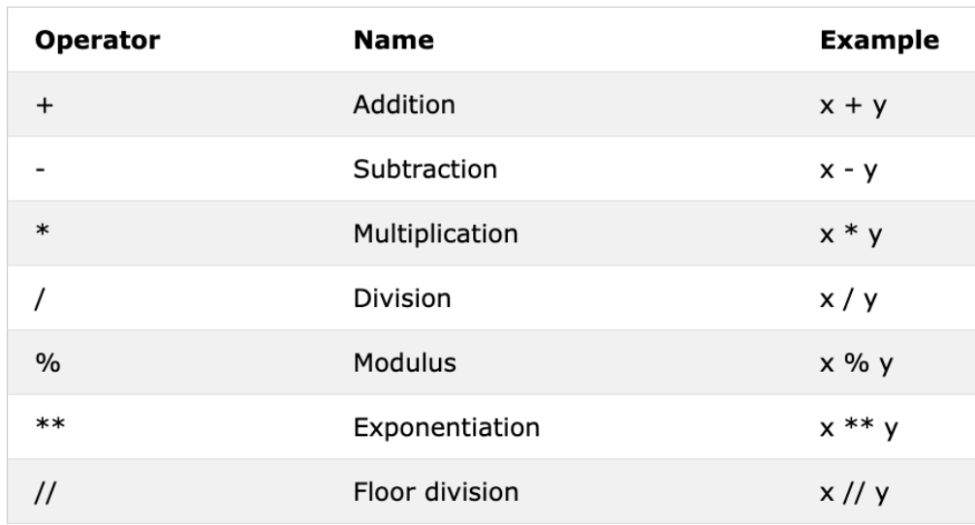
Mathematical Operators

Slide 13
Mathematical Operators
Exercise: Find an Euclidian distance between (2, 3) and (10, 8)

Slide 14
Mathematical Operators
Exercise: For a given temperature in celsius stored in variable ‘t_c’, get the Fahrenheit temperature in ‘t_f’ and display result.
  Let t_c = 100
  ans = 212

Slide 15
Checking Data Types
Exercise: What would be the data-type of?
  >>> a = 4/3
  >>> type(a)
  >>> n = 4//3
  >>> type(a)
  >>> num = ‘2080’
  >>> type(num)

Slide 16
Type Casting
Converting one data type to another data type.
We use int(), float(), str()
  >> # float to int
  >> gravity = 9.81
  >> print(int(gravity))

Slide 17
Type Casting
When we do arithmetic operations string numbers should be first converted to int or float otherwise it will return an error.
  >> #str to int or float
  >> num_str = '10.6‘
  >> print('num_int', int(num_str))
  >> print('num_float', float(num_str))

Slide 18
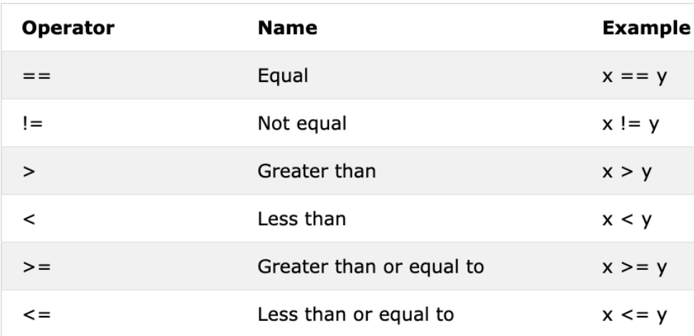
Comparison Operators

Slide 19
Comparison Operators
In programming we compare values, we use comparison operators to compare two values. We check if a value is greater or less or equal to other value.
>> 2 == 2
  >> 3.14 == 3.1416
  >> print(123 == ‘123’)
  >> print(123 == int(‘123’))
  >> a = ‘mango’
  >> b = ‘orange’
  >> a == b
  >> a < b What does this show?

Slide 20
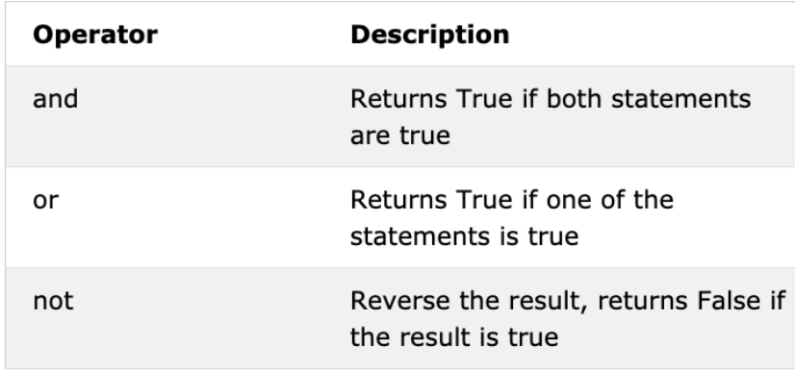
Logical Operators

Slide 21
Logical Operators
Logical operators are used to combine conditional statements:
>> 2 == 2 and 2 < 4
  True
  >> print()
  >>
  >> a = ‘mango’
  >> b = ‘orange’
  >> a == b
  >> a < b What does this show?

Slide 22
Conditionals
In python the key word if is used to check if a condition is true and to execute the block code. Remember the indentation after the colon.
  a = 10
  if a > 3:
  print(a, “is greater than 3”)
if else
  a = 3
  if a > 0:
  print(a, “is positive number”)
  else:
  print(a, “is negative”)

Slide 23
Conditionals
if elif else
  a = 3
  if a > 0:
  print(a, “is positive number”)
  elif a < 0:
  print(a, “is negative number”)
  else:
  print(a, “is zero”)

Slide 24
Operators and Conditionals
Exercise:
How do you check if a number is between 5 and 10 inclusive?
  Note: Use if statement here
  >>> if condition_1 and condition_2:
  ... choice_1
  >>> else:
  ... choice_2
  >>>

Slide 25
Operators and Conditionals
Exercise:
How do you check if a number is even or not using python?
  Note: Use if statement here
  >>> if condition:
  ... choice_1
  >>> else:
  ... choice_2
  >>>

Slide 26
Program for the Day
Calculate Electricity Bill (15Ah)
KWh Minimum Charge Charge per KWh
0 to 20 50 4.00
21 to 30 75 6.50
31 to 50 75 8.00
51 to 100 100 9.50
101 to 250 125 9.50
250 above 175 11

Slide 27
Loops
In programming we also do lots of repetitive tasks. In order to handle repetitive task programming languages use loops. Python programming language also provides the following types of two loops:
  while loop
  for loop

Slide 28
While Loop
count = 0
while count < 5:
print(count)
count = count + 1 #prints from 0 to 4

Slide 29
for Loop
# syntax
for iterator in range(start, end, step):
#loop statements
for i in range(1,10,1):
print(i)

Slide 30
for Loop
num_list = [1,2,3,4,5]
for num in num_list:
print(num)
it_companies = ['Facebook', 'Google', 'Microsoft', 'Apple', 'IBM', 'Oracle', ‘Amazon‘]
for company in it_companies:
print(company)

Slide 31
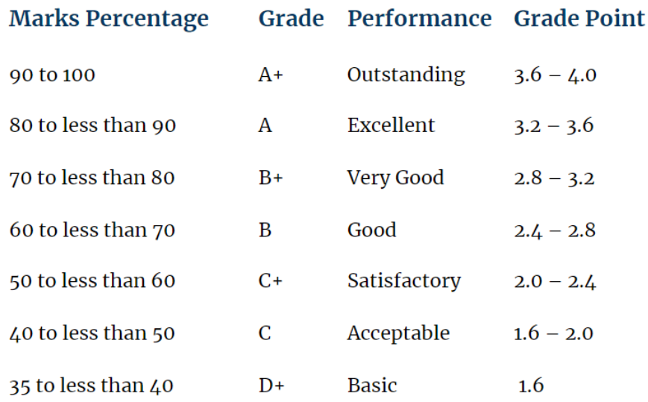
Program for the Day
Student Grading SEE and NEB

Slide 32
Program for the Day
Student Grading SEE and NEB
For a given students’ mark in percentage, display letter grade for each student.
marks = 90
Your code should display “Outstanding”

Slide 33
Program for the Day
Student Grading SEE and NEB
For a list of students’ marks in percentage, display letter grade for each student.
marks = [95, 42, 78, 45, 89, 90]
Use for loop

